Slide 1
Emotionally Expressive Motion Controller for Virtual Character Locomotion Animations
Diogo Silva
Coordinated by: Prof. Pedro A. Santos & Prof. João Dias

Slide 2
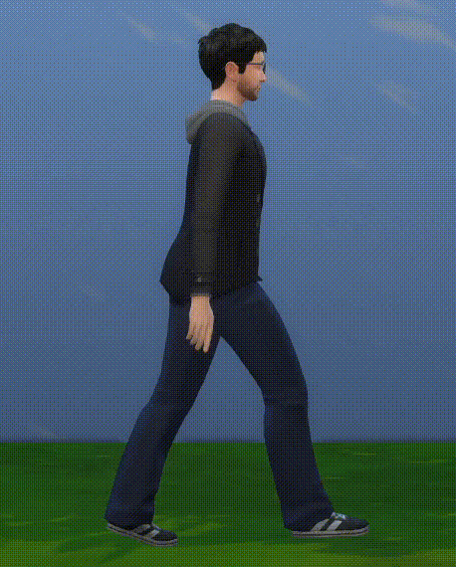
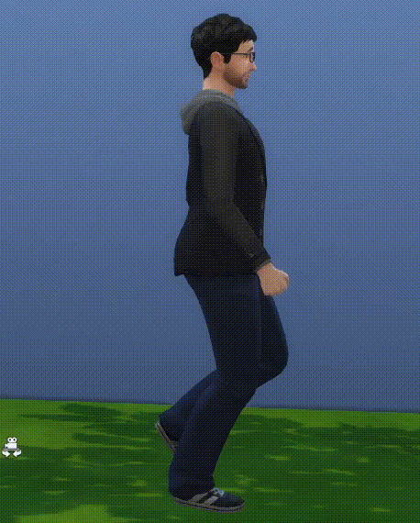
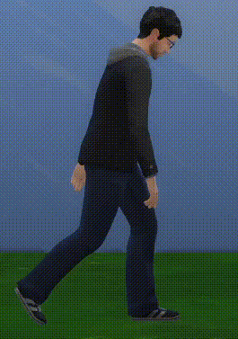
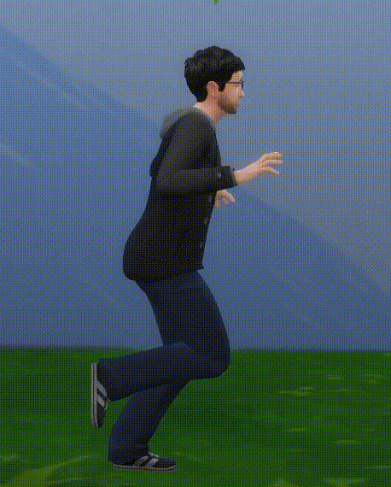
MOTIVATION
"Angry"
"Confident"
"Neutral"
[The Sims 4, Maxis, 2014]
"Energized"
"Sad"
"Afraid"
Notes:
1. Emotional Expressiveness is important in animation para as fazer crediveis, e criar impacto no visualizador
2. Expressao Emocional pode ser feita por expressao facial, voz, ou, no nosso caso, Linguagem Corporal
3. Exemplo do Sims 4

Slide 3
PROBLEM
New Animation for each Emotion
Variants of Baseline
Repeat Process for each Motion
Time Consuming & Expensive
Animation Stack
[The Sims 4, Maxis, 2014]
Notes:
1. For each new emotion the character has to convey, a new variant animation of the baseline has to be created
2. Problem persists on both conventional computer animation using mocap references AND automatically generated motions
3. This has to be repeated for every different motion
4. Not scalable -> The more emotions the more animations for each motion. The more motions, the more the animation stacks
5. Time Consuming/Expensive/Needs reference mocap to be available

Slide 4
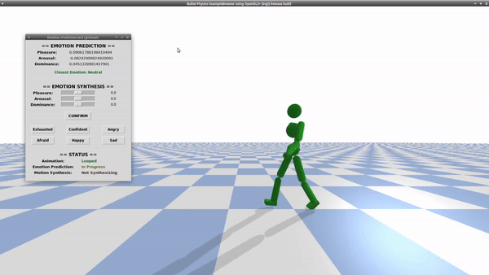
SOLUTION
Automatic
Real-Time
No Additional Data or Training Required
Works with both Kinematic & Policy-Based Physics-Enabled characters
Focused on Locomotion
Based on Machine Learning & Laban Movement Analysis
Emotionally Expressive Motion Controller
Notes:
1. To solve this problem we propose the Emotionally Expressive Motion Controller Framework
2. Tool that allows for both Emotional Prediction and Emotionally Expressive Motion Synthesis in Real Time, without the need of any additional data
3. System uses a combination of Laban Movement Analysis and Machine Learning in order to, not only predict the character's current emotional coordinates in the Pleasure Arousal Dominance model,
But also to allow new desired emotions to be specified, with the system synthesizing and altering the character's motion in real time to convey the new emotion
4. System works with both conventional, mocap-drive Kinematic computer animation and policy-based physics enabled animations generated by state of the art DRL Systems
5. Work has been accepted for publishing at IEEE International Symposium of Multimedia
6. Parallel work is being developed and prepared for publishing in the Virtual Reality Journal

Slide 5
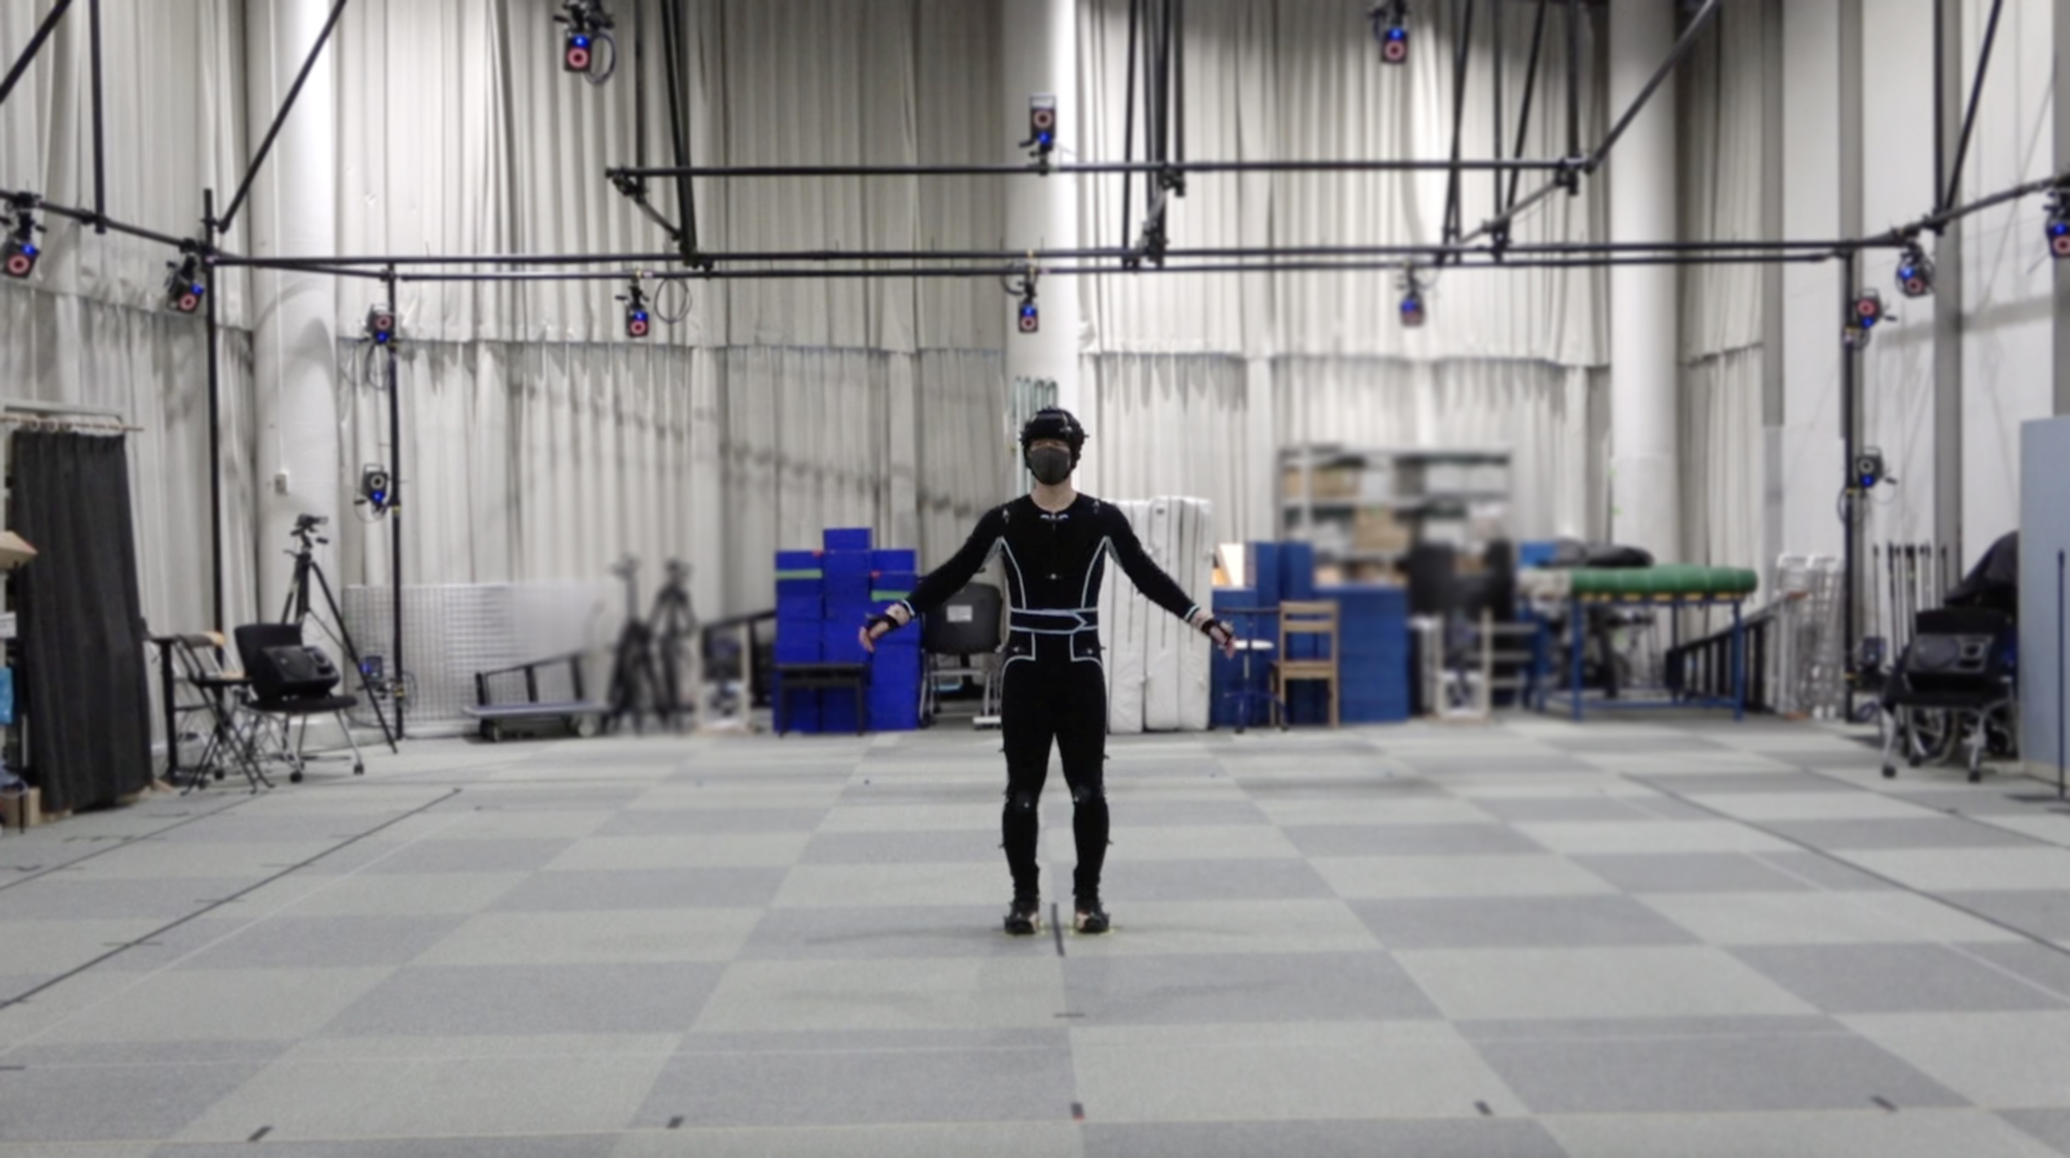
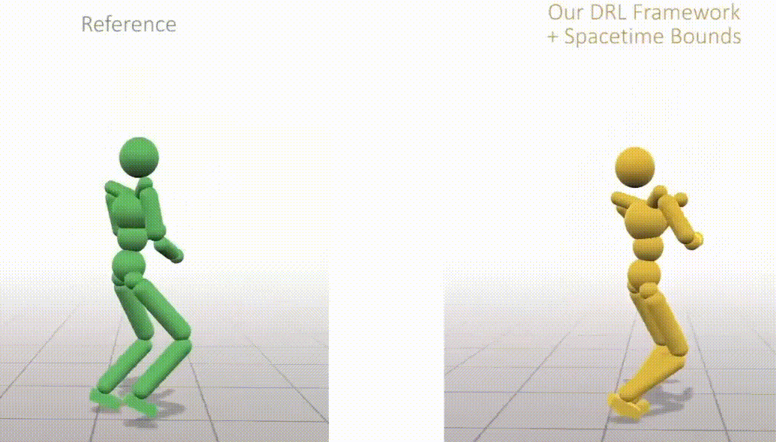
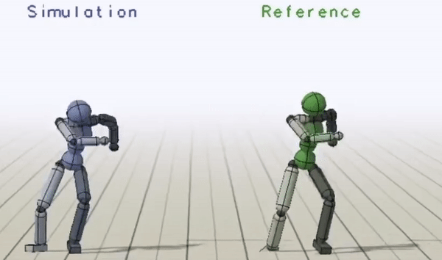
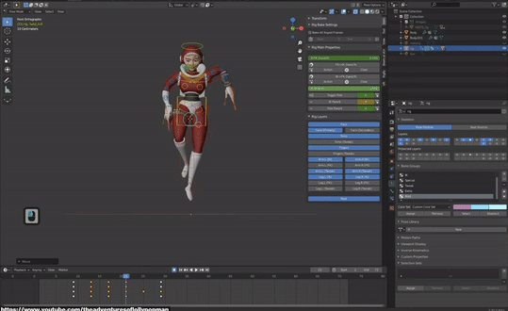
RELATED WORK – DeepMimic & Spacetime Bounds
[Bandai-Namco Research Inc., 2022]
[DeepMimic, Li-Ke Ma et al., 2021]
[Spacetime Bounds, Xue Bin Peng et al., 2018]
Problems:
No way to explicitly audit the outcome animation
No way to tweak a character's motion after training
[https://youtu.be/GuBEup_90EQ?t=350, 2020]
Notes:
1. Conventionally, computer animation is done manually by animators, usually aided by mocap
2. Mocap are recordings of human actors performing a motion in a manner that can be directly applied to a virtual character.
3. Mocap can be used as reference or basis for a new animation
4. Computer animation can be subdivided into 2 categories – Kinematic Controllers & Physics-Based Controllers
5. The basic difference is that in Kinematic Controllers the character's body is not influenced by external physics forces, unlike Physics Controllers
6. As such, Kinematic Controllers are simpler to work with, especially manually. However, recent research and development has been able to create
New systems capable of automatically learning to mimic a reference mocap motion in a physics enabled environment through Deep Reinforcement Learning
7. These recent systems, DeepMimic and SpaceTimeBounds, generate a character controller in the form of a policy that analyzes the current timestep of the character
And its environment to synthesize the next pose to be applied.

Slide 6
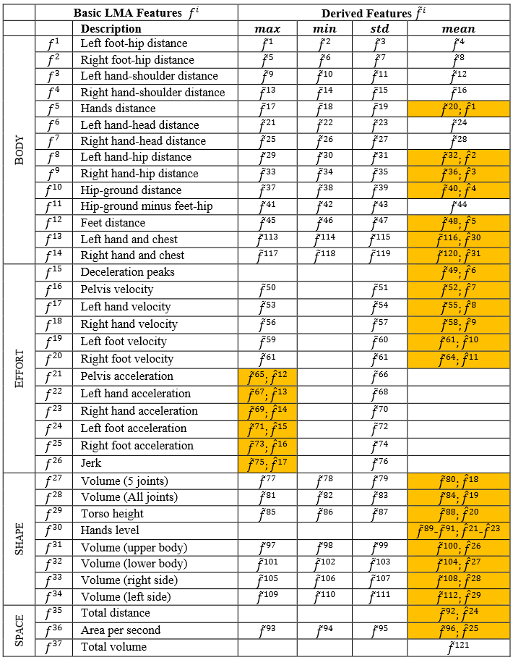
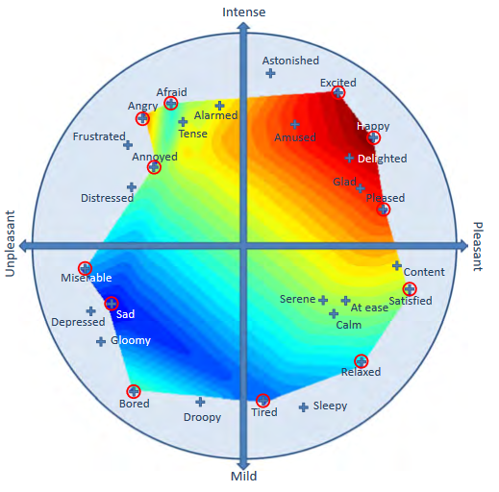
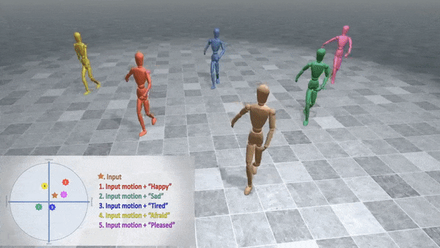
RELATED WORK – Emotion Control of Dance Movements
[Emotion Control of Unstructured Dance Movements, Andreas Aristidou et al., 2017]
Problems:
Does not work with learned Policy-Based Physics-Enabled Controllers
Changes take time to apply
Focuses on non-generic dance animations
Notes:
1. Emotional Models are practical ways of discerning between emotions. They can be either be discrete – there's a finite set of emotions – or continuous
- emotions are categorized according to emotional coordinates, seamlessly blending into each other in a dimensional axis system.
2. One example of these continuous models is the Pleasure, Arousal Dominance Model. This model places emotions into a 3 dimensional axis system
Consisting of the Pleasure axis – which indicates how pleasurable the emotion makes the character – Arousal – which indicates how active or inactive the
Character appears to be – and Dominance – which indicates how dominant or submissive the character feels.
3. The usage of the Dominance axis allows for the consideration of the impact of external factors, such as environment and other actors, upon the character.
4. Laban Movement Analysis is a formal language that allows us to parameterize a character's body in a way that can be easily analyzed.
5. A character's body is described as a set of features belonging to 4 different categories. Body – which includes features describing how a character's body components
Relate to each other – Effort – whose features describe the overall energy displayed by the character – Shape – which describe the character's body as a whole – and
Space which has features indicative of the character's relation to the environment its in.
6. There have been systems developed which have combined the usage of emotional models and LMA for the identification and tweaking of a character's movements, but they
Faltered in some areas such as being incompatible with learned policy-based physics-enabled character controllers, using less descriptive emotional models or being focused on
Less common motions such as dances

Slide 7
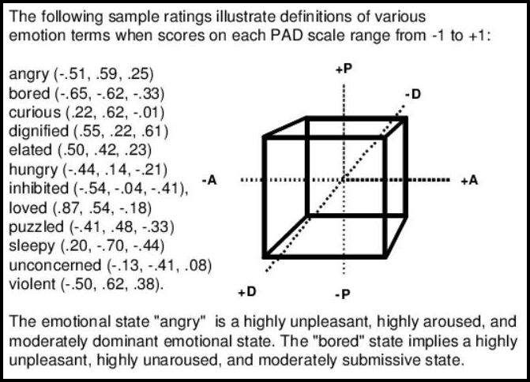
RELATED WORK – Emotion Control of Dance Movements
RCM Emotional Model
PAD Emotional Model
[DeepMimic, Li-Ke Ma et al., 2021]
[Joost Broekens et al., 2004]
[Emotion Control of Unstructured Dance Movements, Andreas Aristidou et al., 2017]
[Spacetime Bounds, Xue Bin Peng et al., 2018]
Problems:
Does not work with learned Policy-Based Physics-Enabled Controllers
Changes take time to apply
Focuses on non-generic dance animations
Notes:
1. Emotional Models are practical ways of discerning between emotions. They can be either be discrete – there's a finite set of emotions – or continuous
- emotions are categorized according to emotional coordinates, seamlessly blending into each other in a dimensional axis system.
2. One example of these continuous models is the Pleasure, Arousal Dominance Model. This model places emotions into a 3 dimensional axis system
Consisting of the Pleasure axis – which indicates how pleasurable the emotion makes the character – Arousal – which indicates how active or inactive the
Character appears to be – and Dominance – which indicates how dominant or submissive the character feels.
3. The usage of the Dominance axis allows for the consideration of the impact of external factors, such as environment and other actors, upon the character.
4. Laban Movement Analysis is a formal language that allows us to parameterize a character's body in a way that can be easily analyzed.
5. A character's body is described as a set of features belonging to 4 different categories. Body – which includes features describing how a character's body components
Relate to each other – Effort – whose features describe the overall energy displayed by the character – Shape – which describe the character's body as a whole – and
Space which has features indicative of the character's relation to the environment its in.
6. There have been systems developed which have combined the usage of emotional models and LMA for the identification and tweaking of a character's movements, but they
Faltered in some areas such as being incompatible with learned policy-based physics-enabled character controllers, using less descriptive emotional models or being focused on
Less common motions such as dances

Slide 8
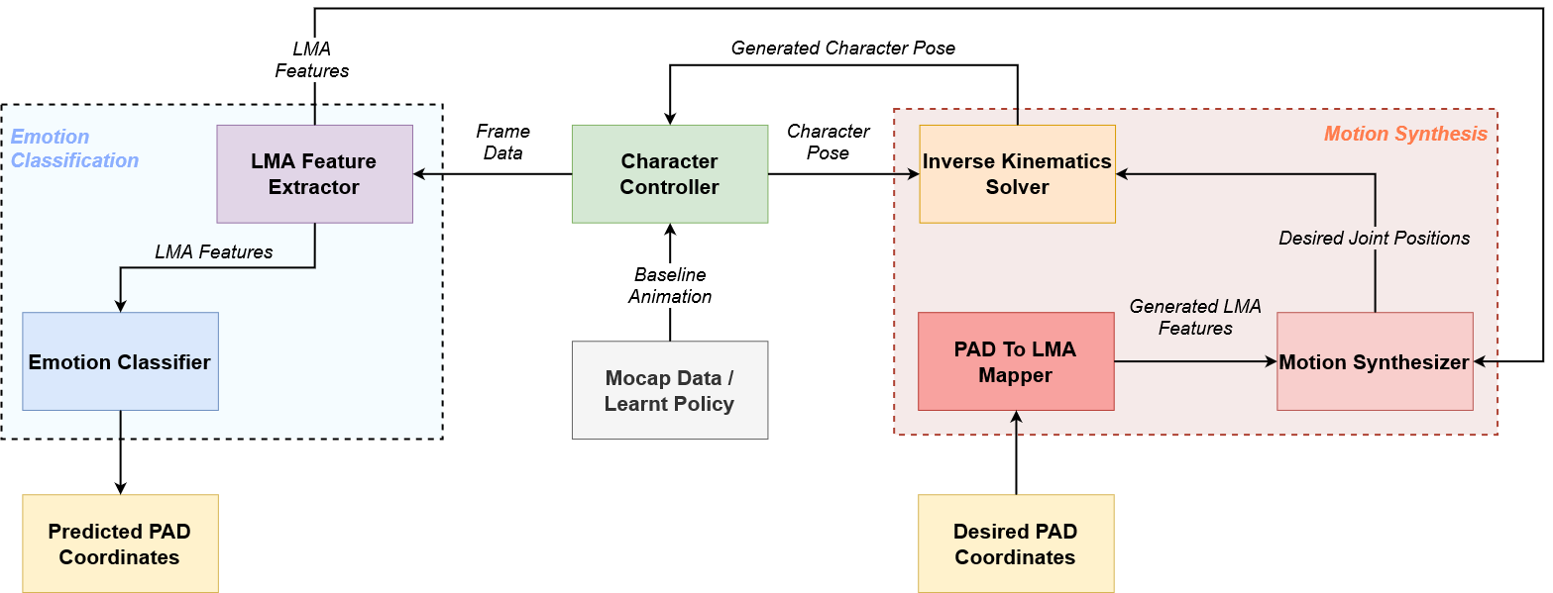
EMOTIONALLY EXPRESSIVE MOTION CONTROLLER
Notes:
1. The Emotionally Expressive Motion Controller Framework can be divided into 2 main subsystems – The Emotion Classification and The Emotionally Expressive Motion Synthesis
2. For Emotion Classification, the system begins by computing a set of LMA features from the frame data extracted from the character. These features are then fed to the Emotion Classifier module which outputs the predicted PAD coordinates.
3. When new desired PAD coordinates are specified they first get converted into a set of LMA Features. This is then given to the Motion Synthesis module which computes new desired joint positions that are then used by the Inverse Kinematics Solver to generate the character's new pose.

Slide 9
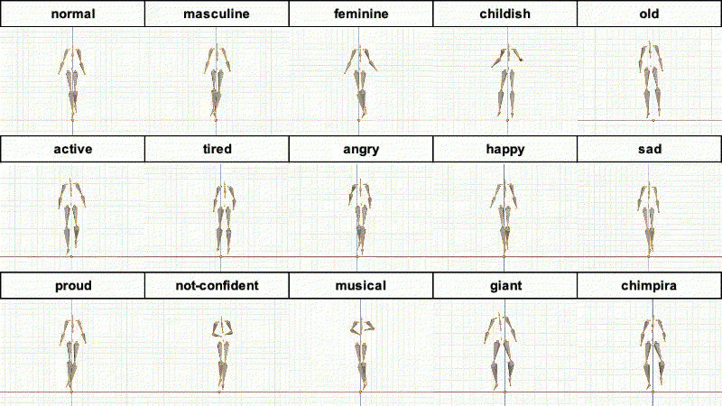
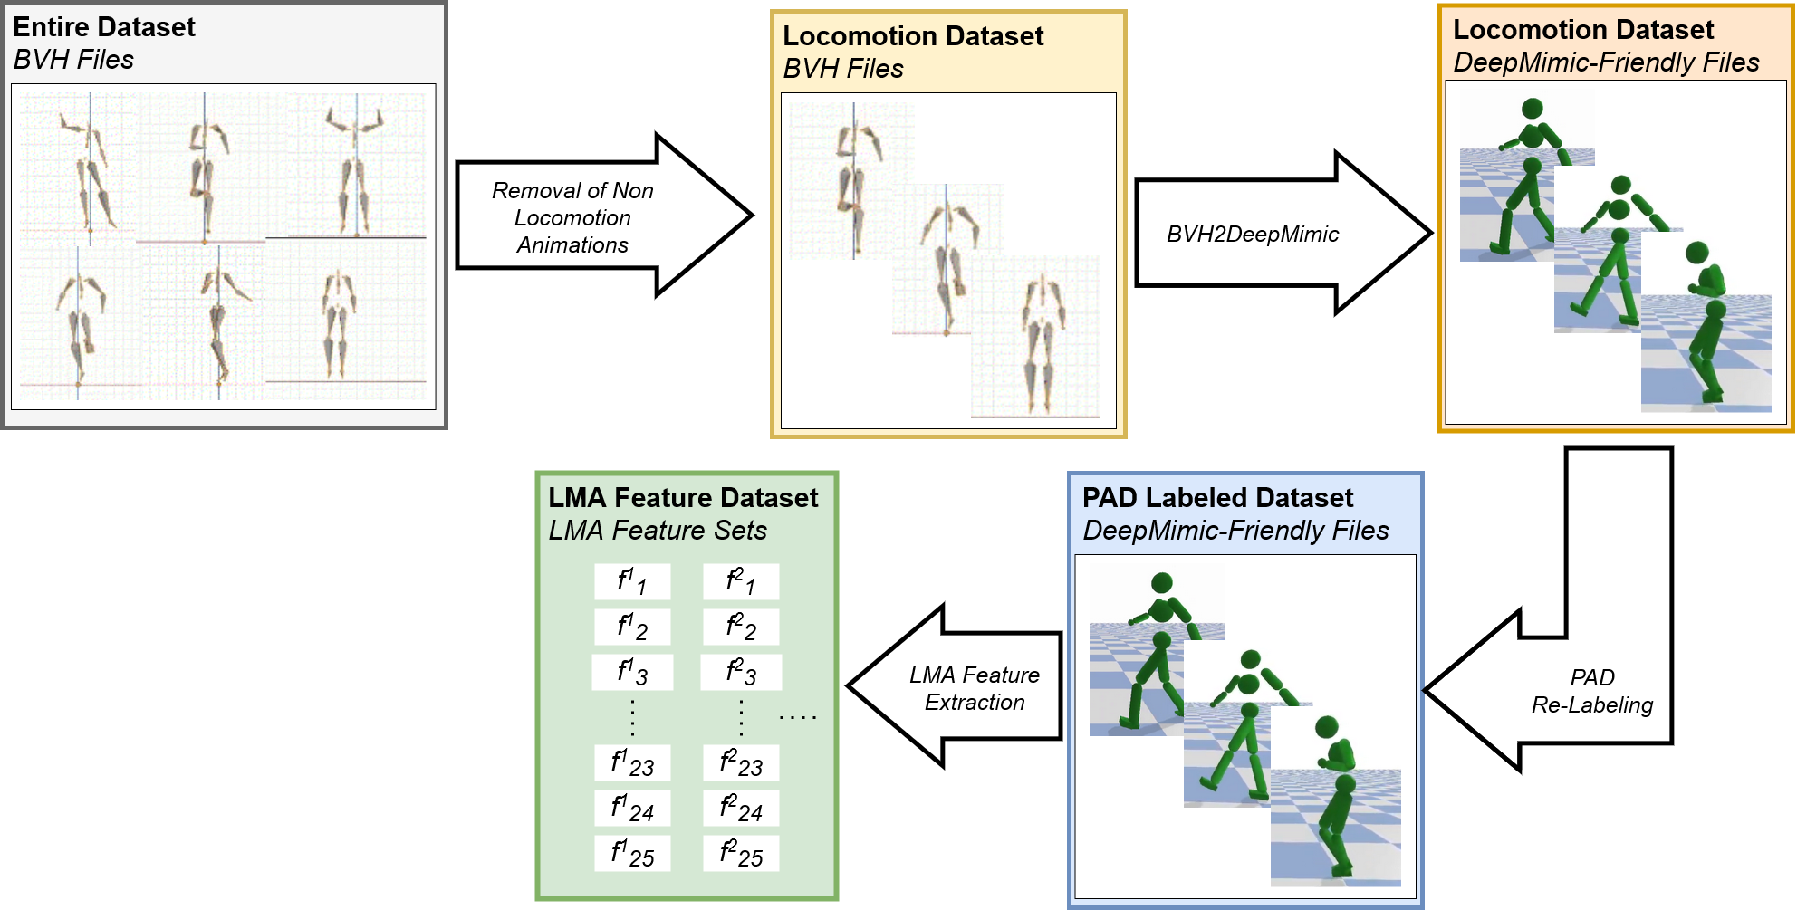
DATASET
Various Motions in different Emotional Styles
Only Locomotion Animations were kept
78551 LMA Feature Sets in 14 different Emotional Styles
Notes:
1. The Bandai-Namco-Research Motion Dataset was used. Contains various types of motions in several different styles.
2. For our efforts, we kept only the locomotion animations – Walks, Runs and Dashes
3. We then converted them from BVH files into a DeepMimic-Friendly format. This was done because our system was built on top of the
SpaceTimeBounds system, which itself was built over DeepMimic. In turn we built on top of SpaceTime Bounds in order to take advantage
Of this system's advanced motion learning capabilities, because we were aiming to make our framework with not only kinematic, but also
automatically generated Policy-based physics-enabled controllers.
4. We then relabeled the emotions by placing them into the PAD dimensional space
5. Finally we extracted the dataset's LMA Features and used those to train our machine learning models.

Slide 10
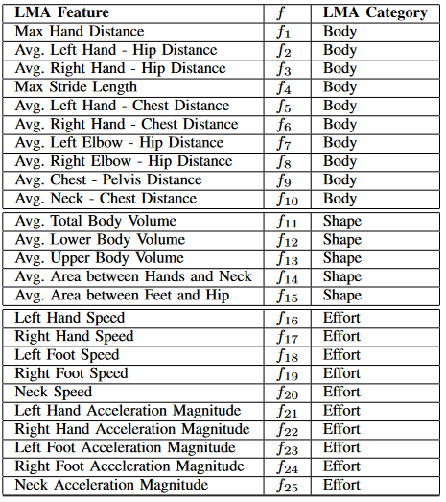
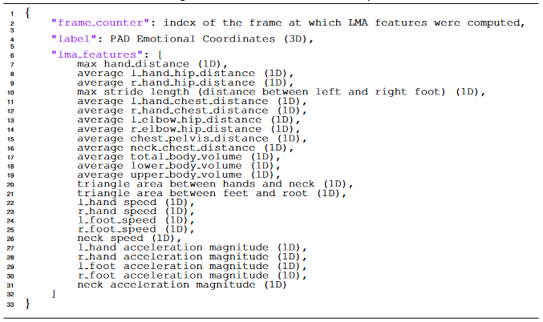
LMA FEATURE EXTRACTOR
Notes:
1. LMA Feature Extractor is responsible for extracting a character's LMA Features throughout its motion. Is used both online to provide the other models with the character's current LMA Features, but also offline
To extract the Dataset's Features.
2. Feature set is composed of 25 LMA Features. Inspired by previous works but also achieved through experimentation in the LMA To PAD regression task.
3. Features are extracted at a 5-frame interval, which for our dataset corresponded to every keyframe, however this parameter, alongside others, can be configured by defining a different extraction rate in seconds.

Slide 11
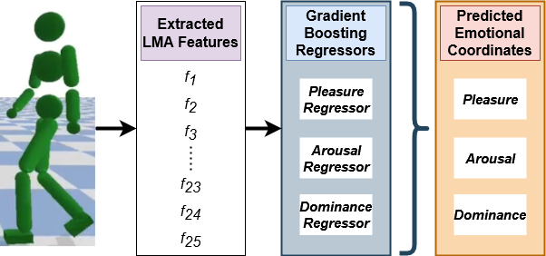
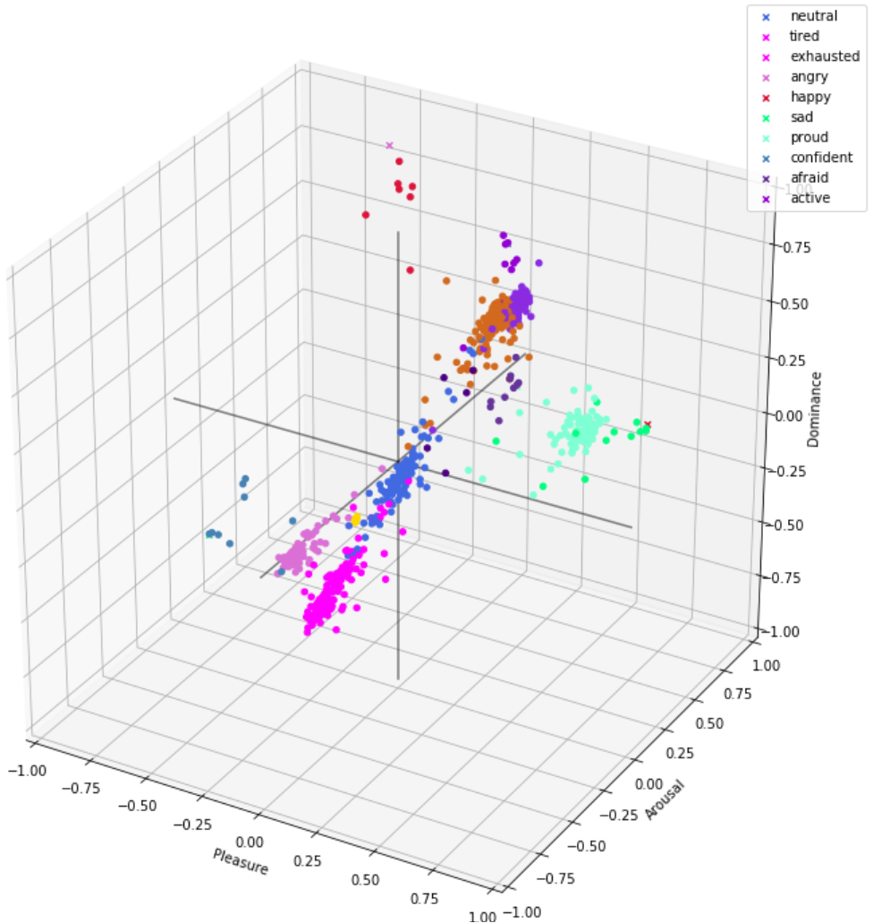
LMA TO PAD REGRESSION
Regressor | MAE
Pleasure | 0.02
Arousal | 0.06
Dominance | 0.03
Notes:
1. To perform emotional classification we use a set of 3 Gradient Tree Boosting Regressors capable of mapping the character's LMA Feature values into a Pleasure, Arousal and Dominance coordinate
2. Data was split into 62841 train/validation samples (80%) and 15710 test (20%)
3. Using XGBoost the models were trained with the optimal hyper parameters having been found using Random-Search 10-Fold Cross Validation over the train/validation set.
4. Models tested using the test set managed a 0.02, 0.06 and 0.03 MAE for P, A and D which is formidable taking into account each value ranges from –1.0 to 1.0. These graphs show
The emotional coordinate values for 100 random test samples, sorted from lowest to highest, and the corresponding predictions made by the regressors. As can be seen the predicted
Silhouette closely follows the original. This other graph shows 1000 random samples placed in the 3D emotional model according to their predictions and colored according to their original
Emotion. We can clearly see the formation of well defined clusters, with predictions very rarely crossing over to incorrect octants.

Slide 12
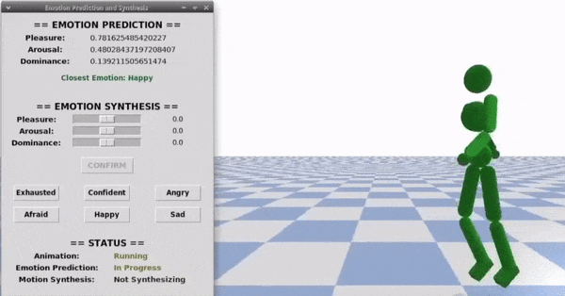
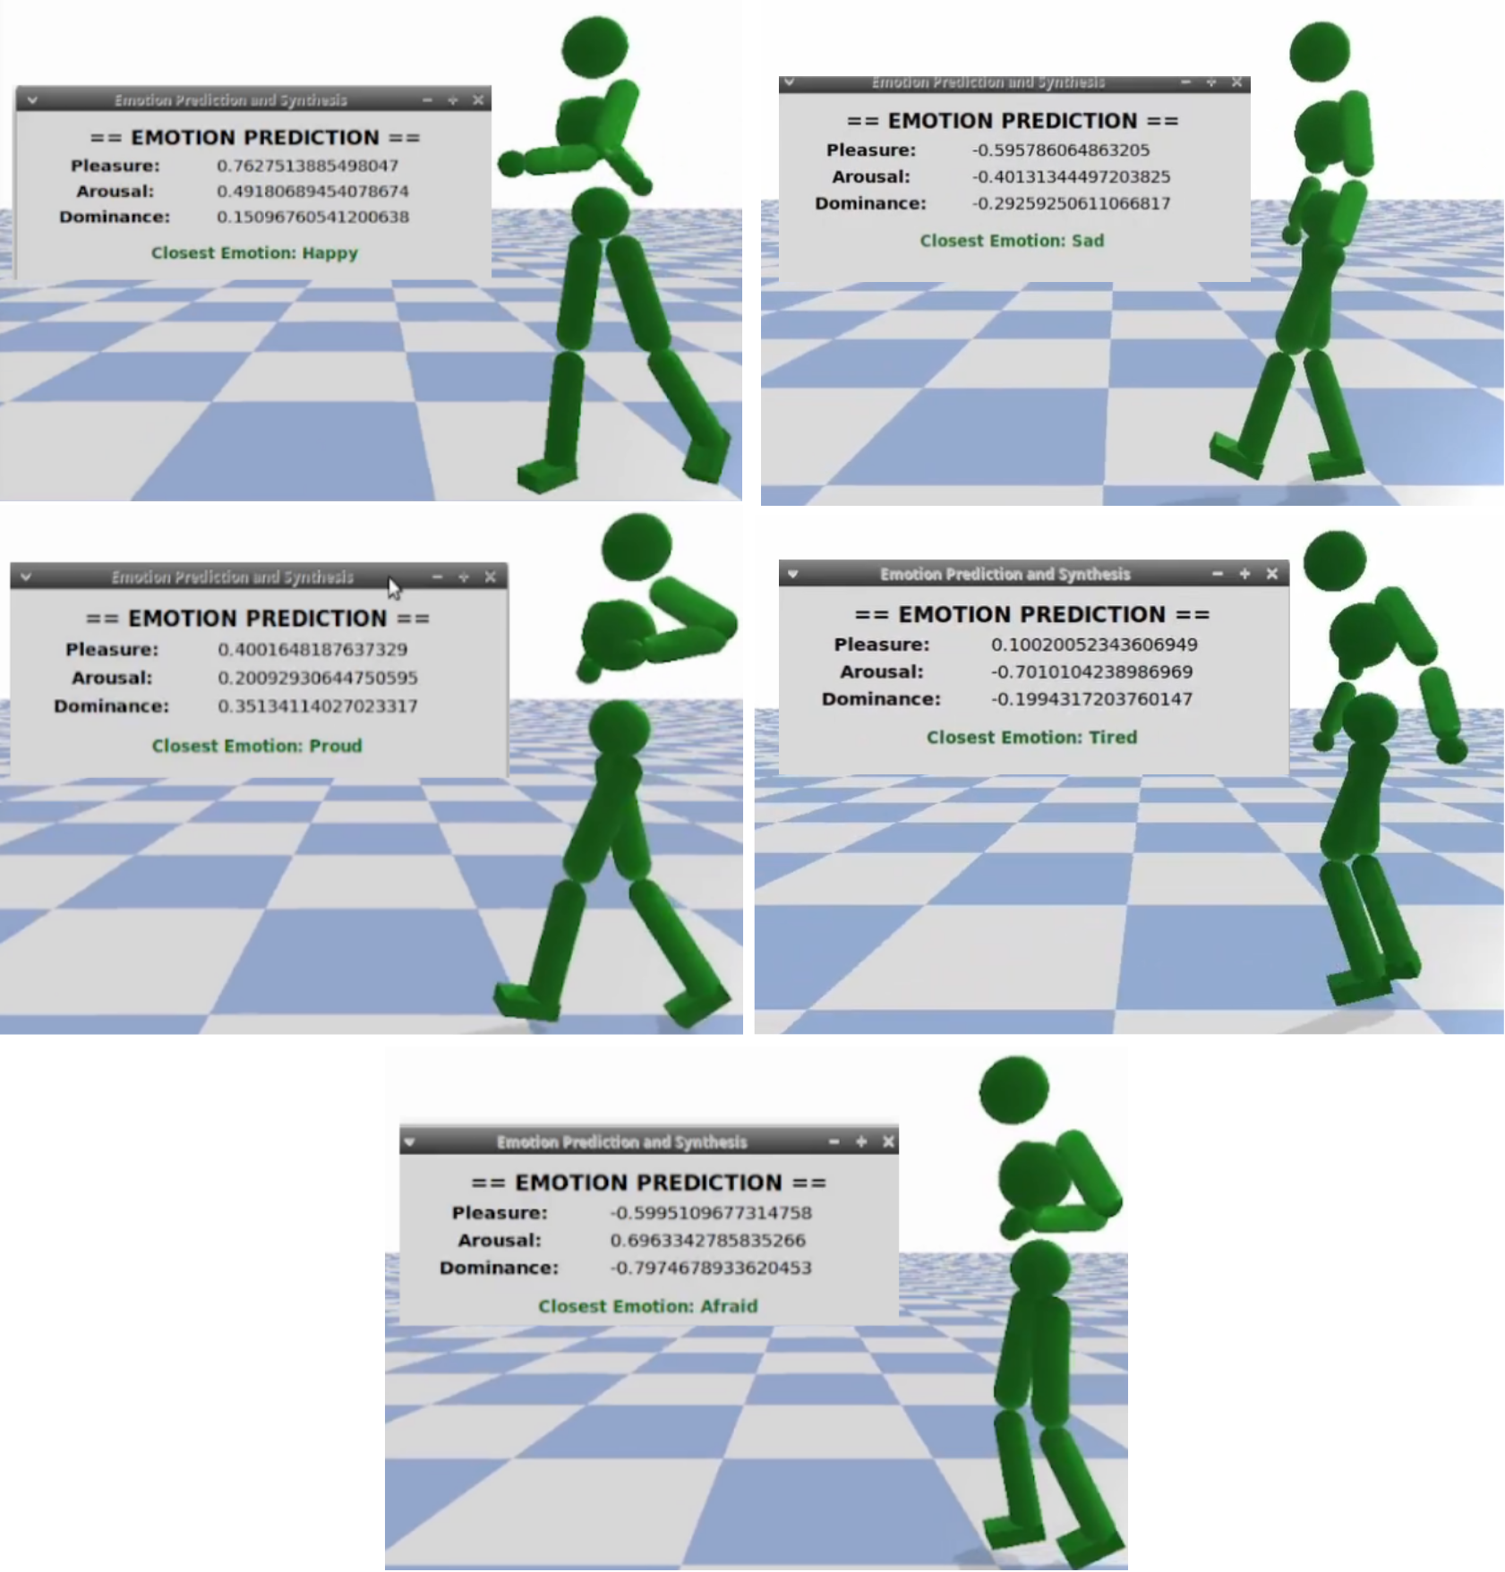
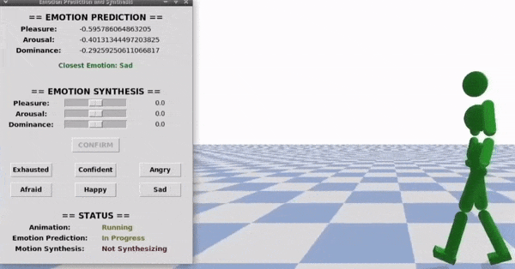
EMOTIONAL CLASSIFICATION
Notes:
1. Using the LMA To PAD Regressors the Emotion Classifier can then predict the character's emotion in real time.
2. During the course of the animation the LMA Features extracted by the LMA Feature Extractor are buffered. When 10 sets are stored a new multi threaded process
Is started. This process will predict the emotion of each stored set, compute the average and output it. The individual predictions are also stored internally
3. At the end of the animation, we use the stored predictions to make a prediction of the animation's overall emotion using a weighted average, giving more weight
To the highest absolute values for each emotion. The idea behind this is that during the course of the animation the emotional intensity of the character can vary,
But it will at some point reach a peak, or valley, value, indicative of the true emotion the character is trying to convey.
4. We can see her the results of our emotional prediction displayed on the showcase GUI and the fact that this process has a pretty much null performance impact on
the animation's showcase.

Slide 13
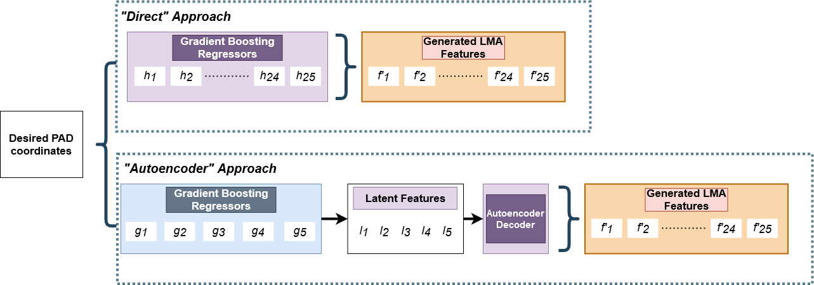
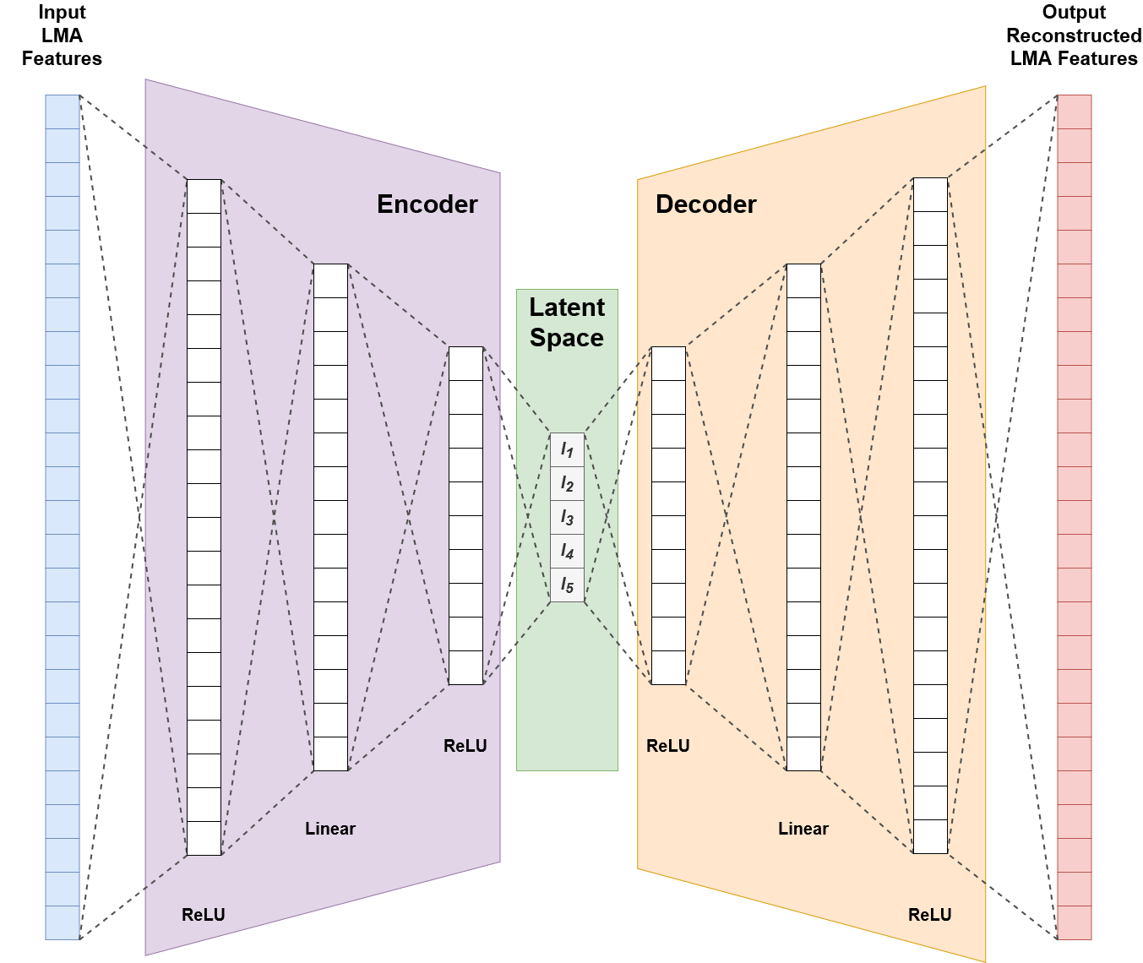
PAD TO LMA REGRESSION
MAE | Direct | AutoEncoder
Pleasure | 0.20 | 0.19
Arousal | 0.30 | 0.24
Dominance | 0.18 | 0.14
Notes:
1. Moving on to Motion Synthesis, the first step is to convert the provided desired PAD coordinates into a set of LMA Features that can then be used for synthesizing
The new motion
2. This was done in one of two ways
3. The direct approach which simply uses a set of 25 Gradient Tree Boosting Regressors to directly map each of the 3 emotional coordinates
Into each of the 25 LMA Features from our set
4. The AutoEncoder approach adds an extra step. An AutoEncoder was first trained to encode and decode the 25 LMA Features into and from a reduced
5-Dimensional Latent Feature Space. The idea stemmed from the fact that regressing 25 outputs from just 3 inputs is a rather complex problem, so perhaps
Reducing the problems complexity into a 3-dimension to 5-dimension mapping problem could harness better results. As such, 5 Gradient Boosting Regressors
Were trained to map the 3 PAD Features into each of the 5 Latent Space ones.
5. These models were trained and tested using the same technique as aforementioned, with parameters being tuned using Random Search 10-Fold CV. The
AutoEncoders architecture was achieved through trial and error, eventually landing us in this architecture, which achieved an overall mean absolute reconstruction error of 0.17.
6. The models performances was evaluated by using the LMA To PAD Regressors to predict the coordinates of both the original and generated LMA Features
And then computing the error between the predicted PAD coordinates for the original and generated features. For the Direct Approach an MAE of 0.20, 0.3 and 0.18 was achieved
For the Pleasure, Arousal and Dominance coordinates. The AutoEncoder approach did considerably better reducing all errors and landing on 0.19 Pleasure, 0.24 Arousal and 0.14 Dominance.

Slide 14
MOTION SYNTHESIS
Compute new desired positions/rotations for core joints
6 Heuristic Rules
Coefficients to represent the difference between Baseline's and Generated LMA Features
Notes:
1. So now for the actual process of motion synthesis. During the baseline animation's first playback all LMA Features computed by the LMA Feature Extractor are stored internally
So that we always have the Baseline LMA Features.
2. When new coordinates get specified the system begins by using either PAD To LMA methodologies to generate a new
Set of LMA Features
3. Then the Motion Synthesis module starts a new multi threaded process. This module uses a set of 6 heuristic rules to determine new core joint positions/rotations for the character.
The core joints include the Hips, Chest, Hands, Elbows, Feet and Neck. We focused primarily on upper body joints since studies have proven that these are the main joints used for emotional
Expression, whilst lower body joints are mainly used for stabilization. Each rule has a coefficient and a set of features associated with the joint it is trying to change.
4. The idea behind each rule is basically to modify the character's joint in order to bring its LMA Features closer to the generated ones. To do so, each rule has coefficients which act as
A value representative of the difference between the generated and baseline subset of LMA Features for that rule.
5. Whenever new LMA Features are generated, we first compute the coefficients for each rule. These coefficients are computed as the value that minimizes the error
Between each rule's subset of LMA Features. This basically boils down to an optimization process of minimizing this equation for coefficient c
which is solved using Powells method. Each coefficient is initialized at 1.0.
6. After having the coefficients each rule can be called to generate the new joint positions sequentially by modifying the baseline's. This can be done either as a batch, where we generate the new
Set of joint positions and rotations for each of the character's poses at once, or every single frame. It should be noted that the batch method only works when we have
A Kinematic character controller, which gives us access to the character's pose at every keyframe, meaning we can generate the new positions for every one of them at once. This is not the case
For learned policy-based physics-enabled controllers which generate the character's pose at every frame, meaning we have to compute the modifications right after the pose is generated.

Slide 15
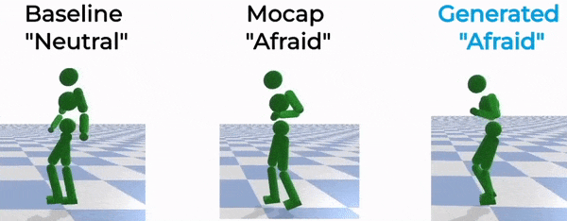
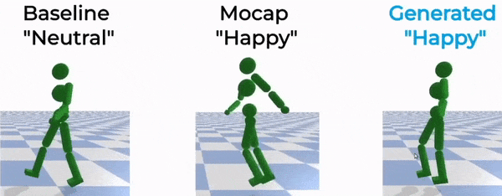
INVERSE KINEMATICS
Notes:
1. Just having the character's desired joint positions is not enough however. A new pose has to be synthesized by modifying the baseline pose in order to move the joints to their desired positions
Without breaking the character's line of motion, or twisting its body unnaturally. To do so we use an Inverse Kinematics Solver to generate and output the new poses.
2. These poses can then be directly applied to the character, replacing its baseline pose, which effectively will alter its movements in order to convey the new desired emotion, as can be seen here.

Slide 16
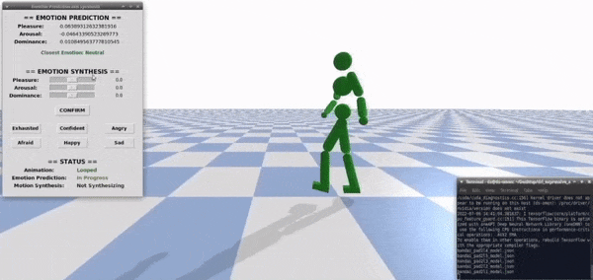
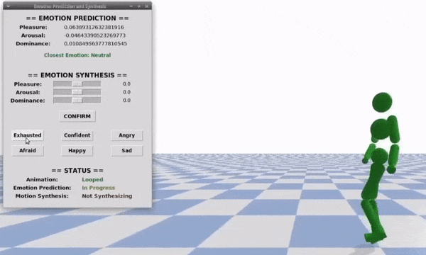
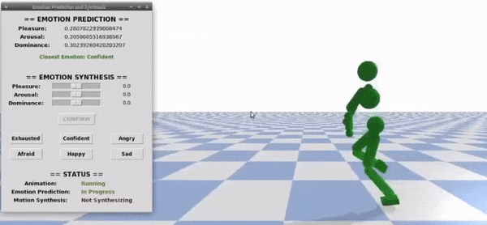
EMOTIONALLY EXPRESSIVE MOTION CONTROLLER
Notes:
1. And that’s the basic jist of our Emotionally Expressive Motion Controller. Our framework was created using the PyBullet Graphics and Physics Engine.
2. We built our framework over the Spacetime Bounds' system in order to make use of its motion learning capabilities. As such, our framework
Can be started with either policy-based physics-enabled character controllers or a kinematic controller reading directly from a mocap files.
3. We added a complimentary GUI in order to showcase our Emotional Prediction and Motion Synthesis capabilities. This GUI shows each predicted emotional
Coordinate's results, but also the closest discrete emotions, from a set of predefined ones, color coded in accordance to how close it is to the coordinates.
4. It also allows users to specify new desired coordinates in order to trigger the motion synthesis. This synthesis, and the prediction, both occur in real time
With changes being applied almost immediately with no discernable slowdown to the character.
5. We focused our efforts towards locomotion animations, hence our system works best when provided with a baseline motion of this type – Walks runs and dashes.
However, it also works with non-locomotion animations, to a varying degree of success.

Slide 17
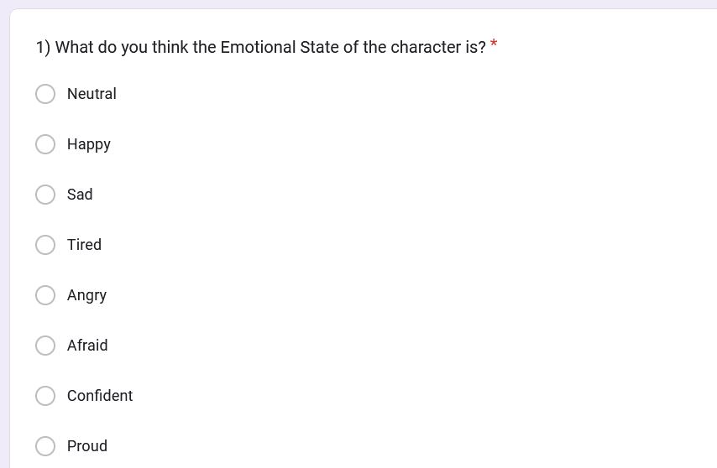
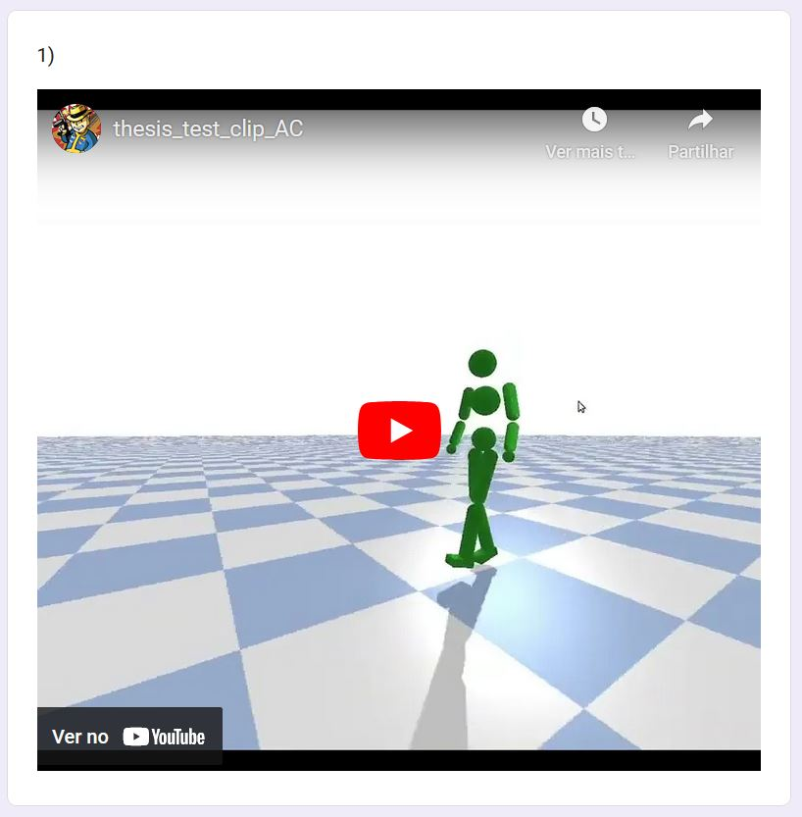
USER TESTS
Emotional Identification Task
Primed Emotional Agreement Task
Notes:
1. To validate the quality of the emotions conveyed by our Emotionally Expressive Motion Synthesis two user tests were conducted counting with the participation of 40
Anonymous, paid participants each. The goal was to both discern whether one of our LMA Feature Generation methods was better than the other, and to compare
The quality of the generated emotions to reference, professionally recorded mocap.
2. The First Test simply had participants view an unlabeled clip and select which emotion they thought the character was trying to convey. These clips were randomly shuffled
And included recordings of reference mocap, and generated motions applied to either kinematic or policy-based characters using either direct or autoencoder methodology.
3. The second test was conducted due to the fact that certain emotions can easily blend into each other when deprived of context. For example, sad and tired are very similar
Emotions that can be easily mistaken for each other, when viewed in a vacuum. For the second task we informed participants of what emotion the character was trying to convey
And then asked them to evaluate on a Likert scale of 1 to 5, how much they agreed that the character was in fact conveying said emotion.
4. After analyzing our results and identifying the presence of statistically significant differences for the answers provided using Friedman and Wilcoxon tests, we were able to reach the conclusion that
For the most part, participants managed to correctly identify and tended to agree with the emotions that the generated motions were trying to convey. This showcases the efficacy of our system
As it proves that we can achieve results with similar emotional expressiveness to professional grade mocap without the need and costs of recording several actors performing each desired emotion.
Both kinematic and policy-based characters had similar performances, but we did note that the AutoEncoder generation approach always outperformed the direct approach which, paired with the fact
That the autoencoder approach takes less time to load at the system's boot, due to having overall less models, makes it the defacto better feature generation approach.

Slide 18
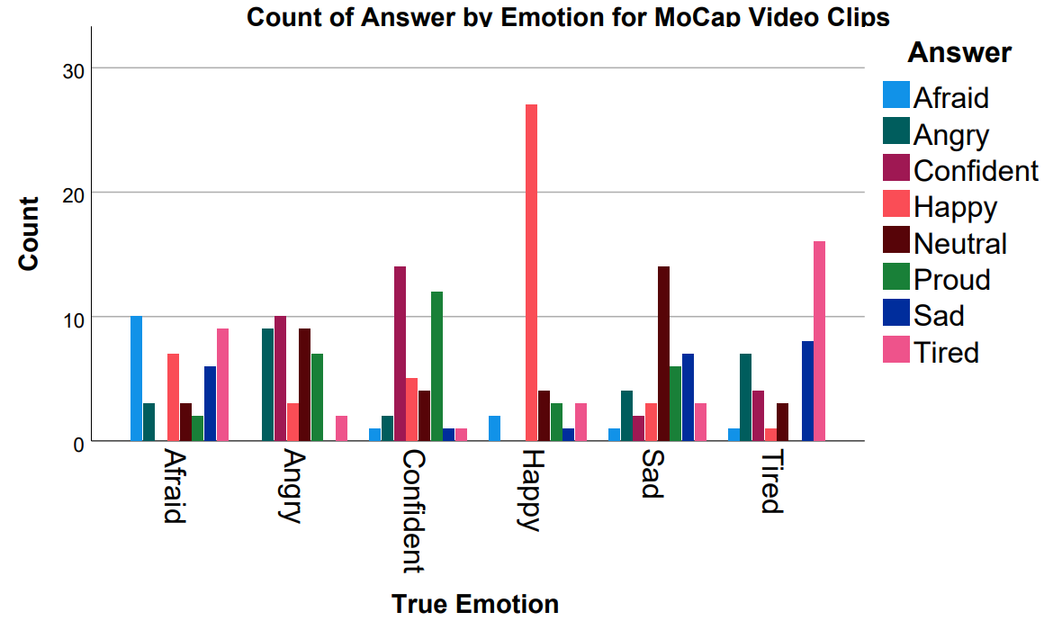
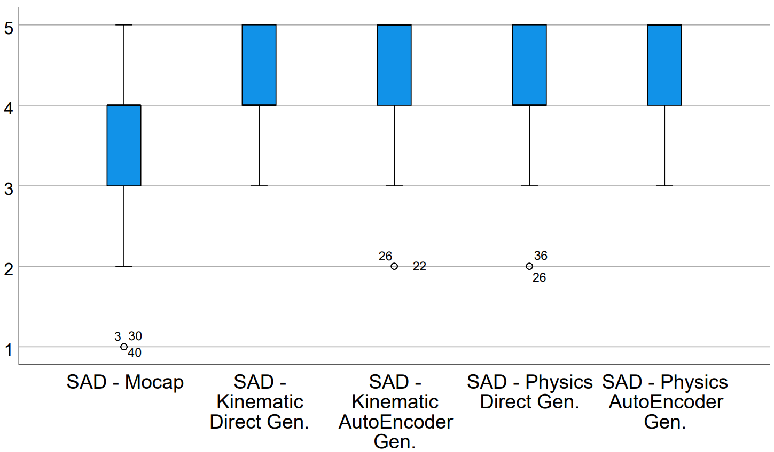
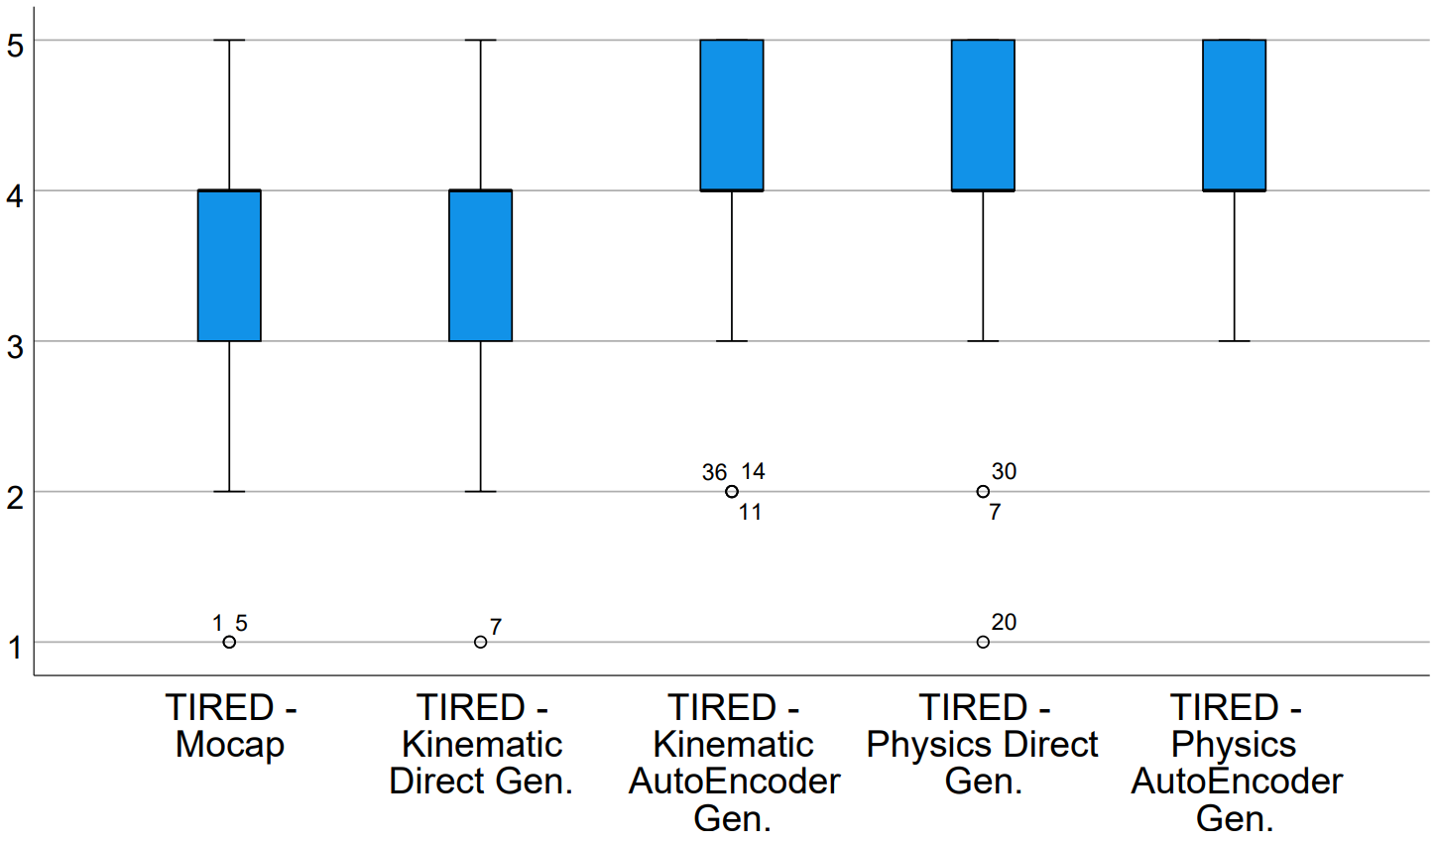
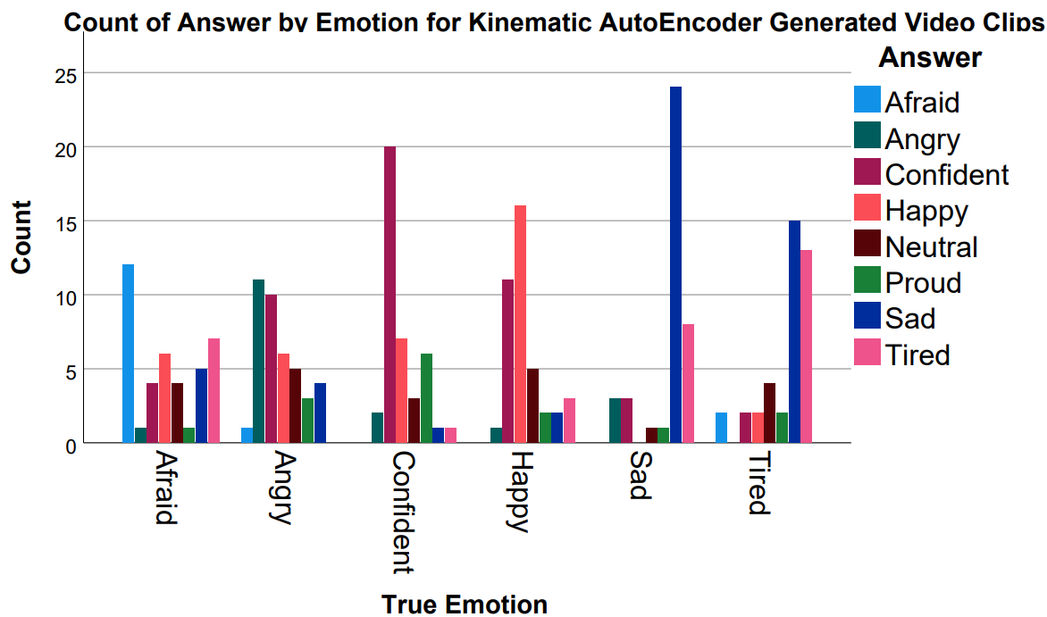
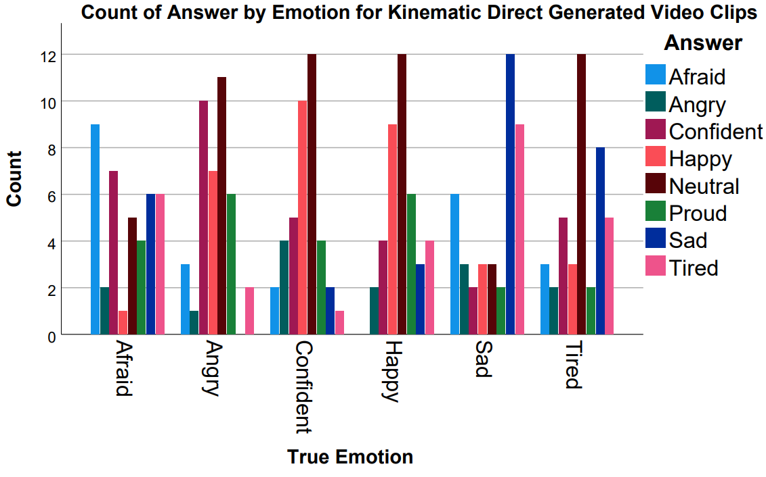
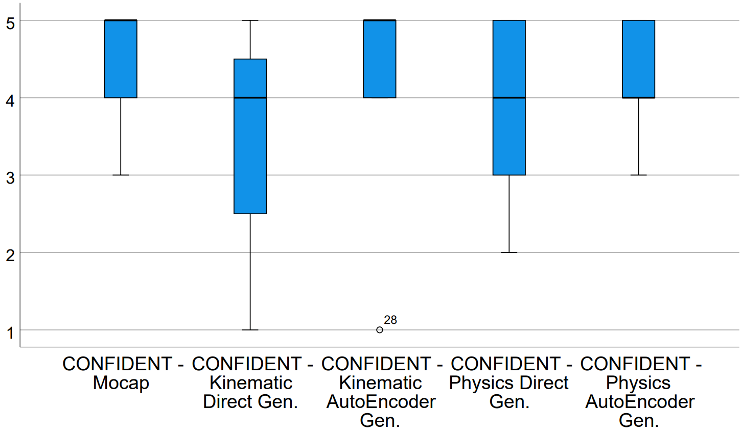
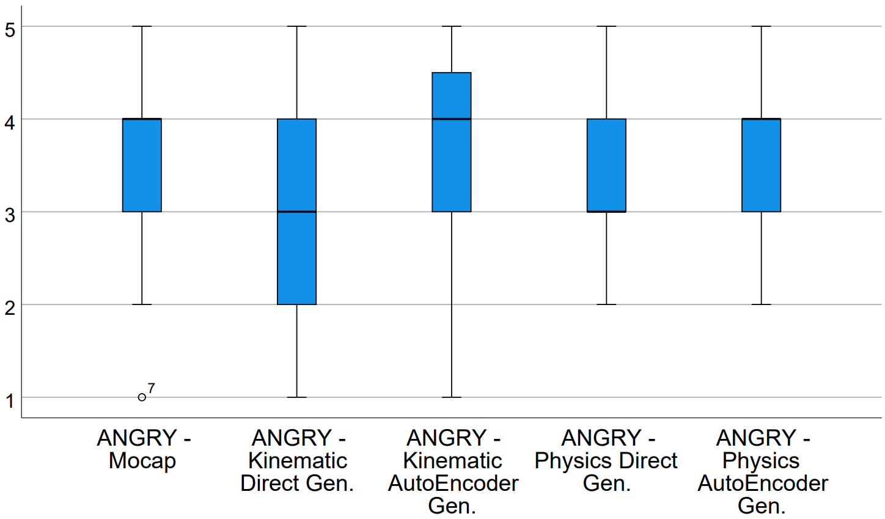
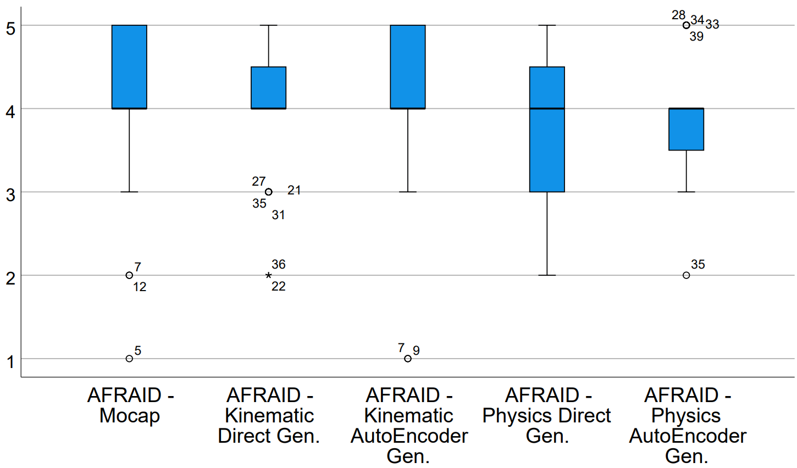
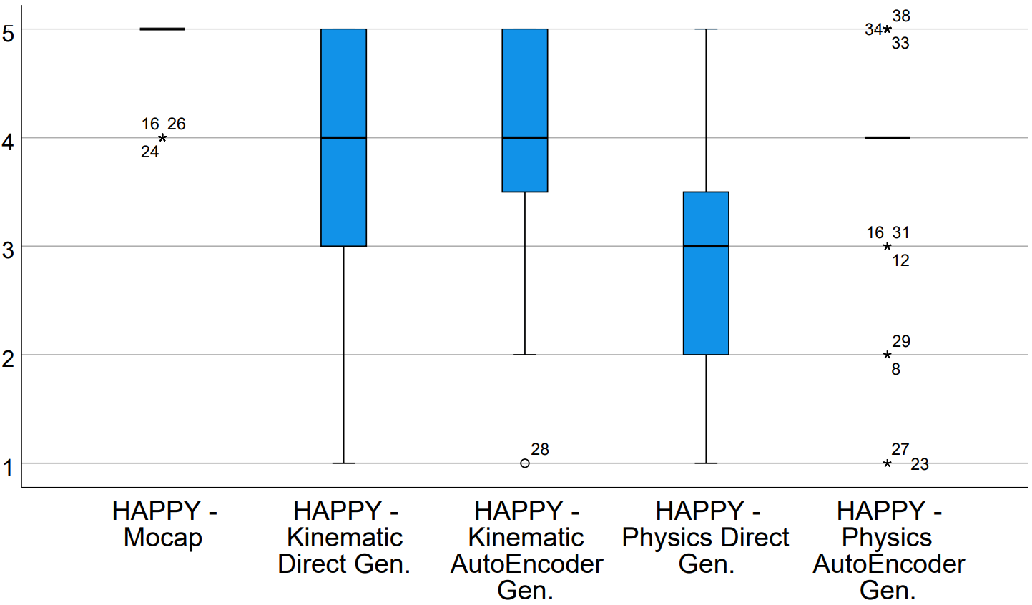
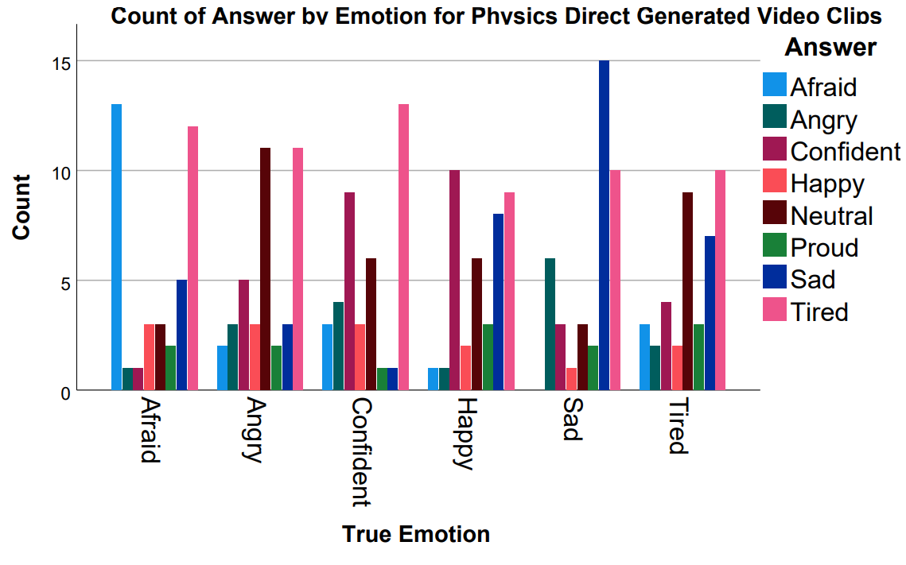
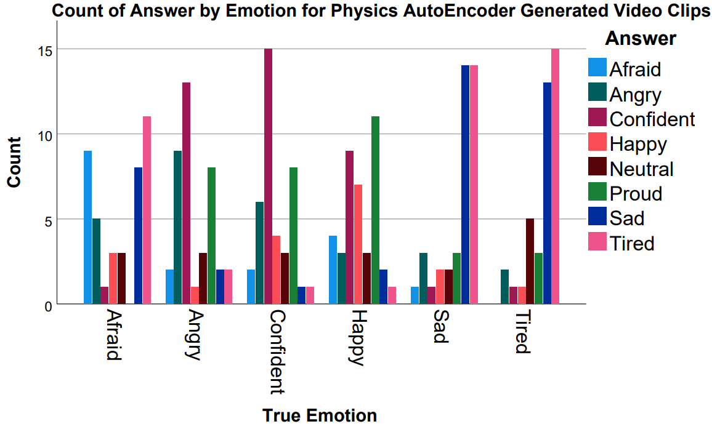
USER TESTS
Emotional Identification Task
Primed Emotional Agreement Task
Notes:
1. To validate the quality of the emotions conveyed by our Emotionally Expressive Motion Synthesis two user tests were conducted counting with the participation of 40
Anonymous, paid participants each. The goal was to both discern whether one of our LMA Feature Generation methods was better than the other, and to compare
The quality of the generated emotions to reference, professionally recorded mocap.
2. The First Test simply had participants view an unlabeled clip and select which emotion they thought the character was trying to convey. These clips were randomly shuffled
And included recordings of reference mocap, and generated motions applied to either kinematic or policy-based characters using either direct or autoencoder methodology.
3. The second test was conducted due to the fact that certain emotions can easily blend into each other when deprived of context. For example, sad and tired are very similar
Emotions that can be easily mistaken for each other, when viewed in a vacuum. For the second task we informed participants of what emotion the character was trying to convey
And then asked them to evaluate on a Likert scale of 1 to 5, how much they agreed that the character was in fact conveying said emotion.
4. After analyzing our results and identifying the presence of statistically significant differences for the answers provided using Friedman and Wilcoxon tests, we were able to reach the conclusion that
For the most part, participants managed to correctly identify and tended to agree with the emotions that the generated motions were trying to convey. This showcases the efficacy of our system
As it proves that we can achieve results with similar emotional expressiveness to professional grade mocap without the need and costs of recording several actors performing each desired emotion.
Both kinematic and policy-based characters had similar performances, but we did note that the AutoEncoder generation approach always outperformed the direct approach which, paired with the fact
That the autoencoder approach takes less time to load at the system's boot, due to having overall less models, makes it the defacto better feature generation approach.

Slide 19
CONCLUSION
Automatic System for Emotionally Expressive Motion Synthesis of Locomotion Animations
No need for extra data or training
Works with both Kinematic and Policy-Based Physics-Enabled Character Controllers
Emotions specified using the PAD Model
Emotional Prediction and Motion Synthesis in Real Time
Quality of synthesized motions validated through User Tests
Work accepted for publishing in IEEE ISM 2022
Notes:
1. So in conclusion, we have built a system that allows users to easily alter a character's baseline motion in order to make it convey different emotions, without the need for extra
Data or manual animation labor. Furthermore the system works with both kinematic character controllers reading directly from a mocap file, or by automatically learned policy-based
Physics enabled character controllers.
2. Our framework synthesizes motions in real time, meaning it could be used to both directly generate new animations offline to be stored and used later, or online by an application
That requires characters to shift their emotions without resorting to interpolating between different animation files
3. New emotions can be specified through PAD coordinates, which gives a higher grade of control over the intensity of the outcome emotion.
4. Our system was validated through a set of user tests and has been since reviewed and accepted by field specialists for publishing in an international IEEE conference.
---
1. There are, however, ways we could further improve our system.
2. For one it would be beneficial to expand the dataset used to train the models, not only to make it more compatible with non-locomotion animations, but also
To increase the number of emotions in the train set.
3. We also experimented with the usage of Generative Adversarial Networks and Variational AutoEncoders for feature generation, but were unable to reach results
Better than the aforementioned techniques for LMA Feature Generation. We believe this avenue is still worthy of exploring, however, especially with an extended dataset of motions.

Slide 20
Thank you for listening!
More Info at: https://heroufenix.github.io/expressive_animations_web/

Slide 21
INDEX
Motivation
Related Work
Emotionally Expressive Motion Controller
User Testing
Conclusion

Slide 22
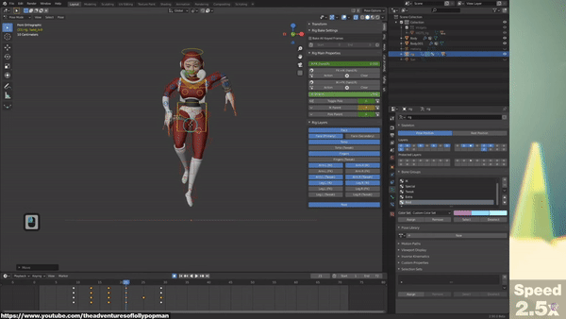
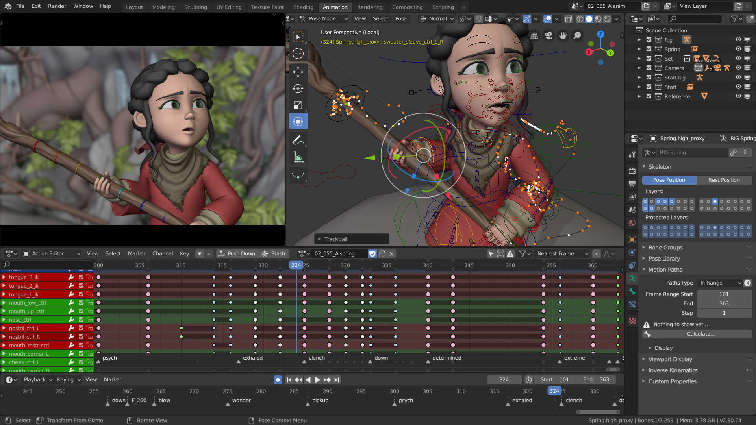
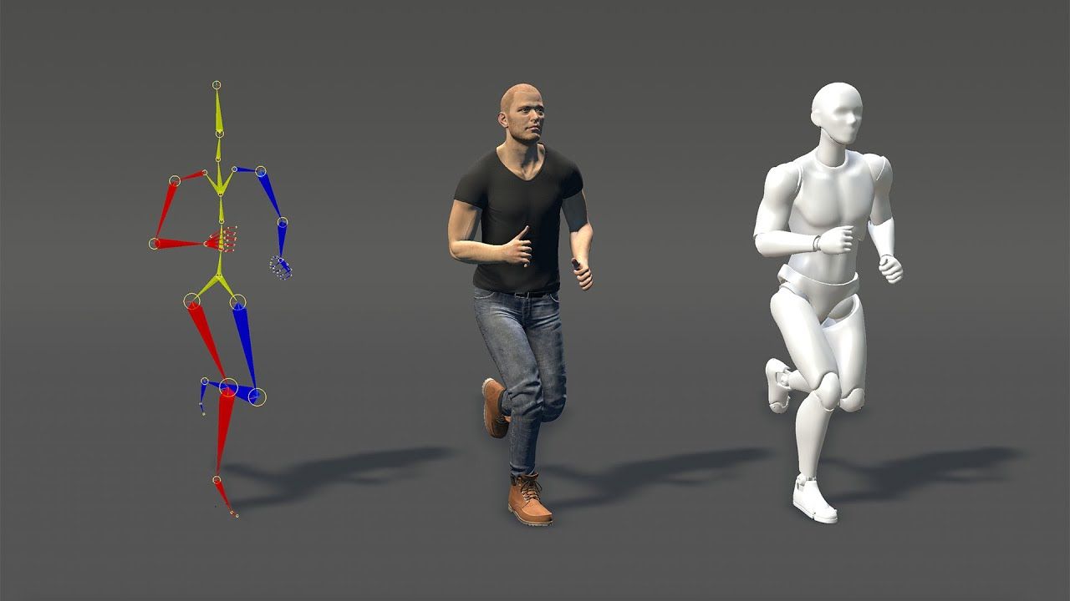
BACKGROUND – Computer Animation
Kinematic Controllers
[https://youtu.be/GuBEup_90EQ?t=350, 2020]
[Blender, 2022]
[Bandai-Namco Research Inc., 2022]
[DeepMimic, Li-Ke Ma et al., 2021]
[https://youtu.be/z93e5_7P54g, 2020]
Physics Controllers
[Spacetime Bounds, Xue Bin Peng et al., 2018]
Notes:
1. Conventionally, computer animation is done manually by animators, usually aided by mocap
2. Mocap are recordings of human actors performing a motion in a manner that can be directly applied to a virtual character.
3. Mocap can be used as reference or basis for a new animation
4. Computer animation can be subdivided into 2 categories – Kinematic Controllers & Physics-Based Controllers
5. The basic difference is that in Kinematic Controllers the character's body is not influenced by external physics forces, unlike Physics Controllers
6. As such, Kinematic Controllers are simpler to work with, especially manually. However, recent research and development has been able to create
New systems capable of automatically learning to mimic a reference mocap motion in a physics enabled environment through Deep Reinforcement Learning
7. These recent systems, DeepMimic and SpaceTimeBounds, generate a character controller in the form of a policy that analyzes the current timestep of the character
And its environment to synthesize the next pose to be applied.

Slide 23
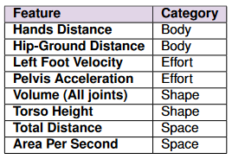
BACKGROUND – Emotional Models & Laban Movement Analysis
PAD Emotional Model
LMA
Body
Space
Effort
Shape
[Joost Broekens et al., 2004]
Notes:
1. Emotional Models are practical ways of discerning between emotions. They can be either be discrete – there's a finite set of emotions – or continuous
- emotions are categorized according to emotional coordinates, seamlessly blending into each other in a dimensional axis system.
2. One example of these continuous models is the Pleasure, Arousal Dominance Model. This model places emotions into a 3 dimensional axis system
Consisting of the Pleasure axis – which indicates how pleasurable the emotion makes the character – Arousal – which indicates how active or inactive the
Character appears to be – and Dominance – which indicates how dominant or submissive the character feels.
3. The usage of the Dominance axis allows for the consideration of the impact of external factors, such as environment and other actors, upon the character.
4. Laban Movement Analysis is a formal language that allows us to parameterize a character's body in a way that can be easily analyzed.
5. A character's body is described as a set of features belonging to 4 different categories. Body – which includes features describing how a character's body components
Relate to each other – Effort – whose features describe the overall energy displayed by the character – Shape – which describe the character's body as a whole – and
Space which has features indicative of the character's relation to the environment its in.
6. There have been systems developed which have combined the usage of emotional models and LMA for the identification and tweaking of a character's movements, but they
Faltered in some areas such as being incompatible with learned policy-based physics-enabled character controllers, using less descriptive emotional models or being focused on
Less common motions such as dances

